Slide 1
Supplemental Figures
Discovery of eQTL Alleles Associated with Autism Spectrum Disorder: A Case-Control Study

Slide 2
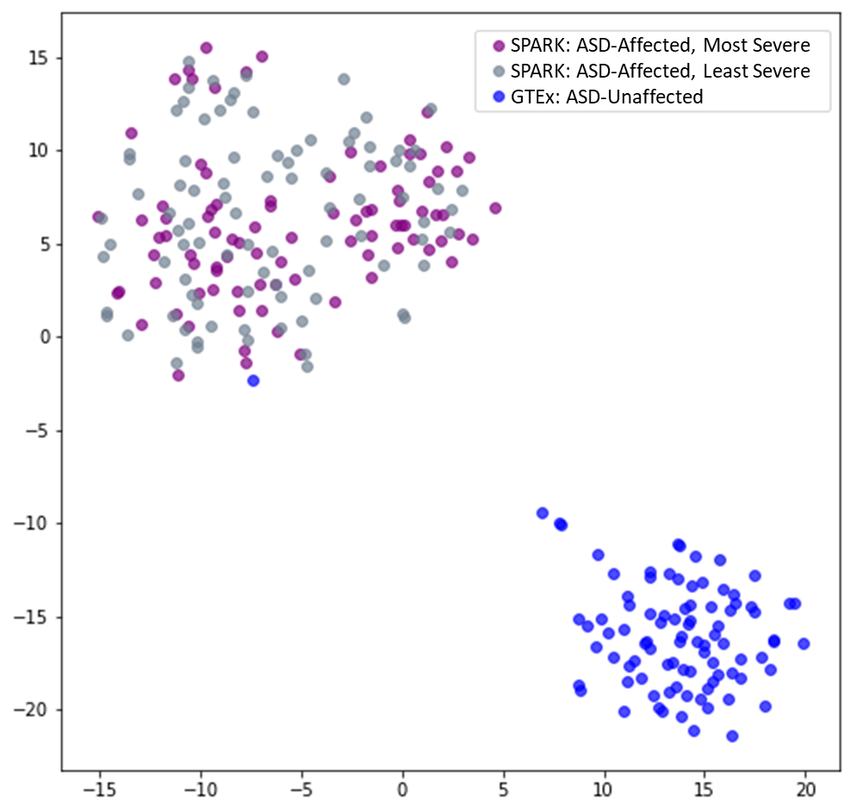
Supplementary Figure 1: tSNE Visualization of Individuals derived from the Caucasian SPARK-GTEx Discovery Population. This plot includes the 90 SPARK ASD-Affected individuals with the most severe phenotypic characteristics, the 90 SPARK ASD-Affected individuals with the least severe phenotypic characteristics, and 90 random GTEx ASD-Unaffected individuals at the 30 significant variants.

